Slide 1
KOKOsoko
PoC Scoping
Updated 12-Mar-2020

Slide 2

Intro to KOKOsoko Concept
The Opportunity -- Our research identified the following stakeholders needs:
KOKO Agents say they are keen on selling consumer durable products (such as electronics, plastic products, motorcycle spare parts, household goods) but they don’t have the suppliers, cash or space to stock these items
Our target Customers do not live in proximity to supermarkets with variety of products; local shops sell only limited stock of durables; no variety; quality varies, and if available, prices are higher than at supermarkets
What we can offer -- an E-Commerce approach which:
Leverages our Agent network to provide Suppliers access to mass-market and taps increased demand for quality durable products,
Leverages existing KOKO hardware and software infrastructure,
Is in line with current retail business model (Customer pays, collects @ Agent),
Does not significantly shift Agent experience and KOKO - Agent relationship,
Is applicable across the entire Agent base, not just a selected few.

Slide 3
Intro to KOKOsoko Concept
Introducing KOKOsoko...
An easy-to-use e-commerce platform based around the KOKOpoint
That enables local access to affordable quality durables otherwise difficult to get
With attractive pricing/promotions developed with product supplier/brand, and
Secure last-mile delivery through the existing KOKO Agent network.

Slide 4
The Value Proposition
SUPPLIERS:
Last mile solution for difficult to reach market segment through a reliable channel and opportunity to capture consumer demand
CUSTOMER:
Local access to affordable quality durables otherwise difficult to get through attractive promotions
KOKOSoko: an e-commerce platform that provides convenient access to affordable quality durables for the low/middle-income urban customer through local SME retailers
KOKO AGENTS:
Additional revenue stream and opportunity for SME retailers to expand their product offering and sell durables which are capital and storage expensive to stock
KOKO NETWORKS:
Additional revenue stream through KOKO margin on KOKOSoko sales

Slide 5
KOKOsoko POC Project : Objective
To build a Minimum Viable Product (MVP) in order to test key assumptions underlying our concept
The KOKOpoint network can be an e-commerce platform for products other than KOKO Cooker
KOKO can develop technical capabilities and operational processes for running this e-commerce platform
KOKO can interest shop clientele in buying products through KOKOpoints.
KOKO Agents are interested in moving non-KOKO products through the KP and generating additional revenue for their businesses.

Slide 6
KOKOsoko POC Project : Scope
KOKO can create and maintain a Digital Catalogue on the KOKOpoint screen with info on what’s for sale & prices.
KOKO can determine which KPs (Agent shops) the KOKOsoko app will be available in.
Anyone (not just KOKO account holder) can view product details on the product catalogue.
User can select & order a product at the KP Screen, and Pay for the selected product via MPESA STK (using KOKO Gift till)
User can receive order confirmation SMS after payment completion or receive order failed notification SMS on payment failure.
When payment is confirmed, the KOKO fulfillment team will receive an email, which will trigger order fulfillment.

Slide 7
KOKOsoko POC Project : Technical Elements
Product management CMS to run within the Special Offers section of KP, displaying 4 pre-selected products (specs & price), with the ability for KOKO to edit / switch out products easily.
Ad targeting functionality to enable KOKO to determine the participating KPs (Agent shops).
Single product purchase journey using a ‘Buy Now’ feature (no ability to create / store user account).
Payment only via MPESA STK push using the Safaricom phone number entered by Customer.
Customer details captured (phone number, item ID, item quantity, total cost, KP Serial (Agent location), timestamp) for order fulfillment.
NB: Fulfillment will be managed manually

Slide 8
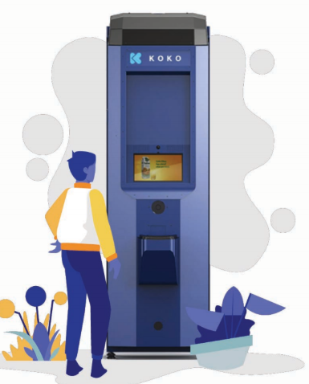
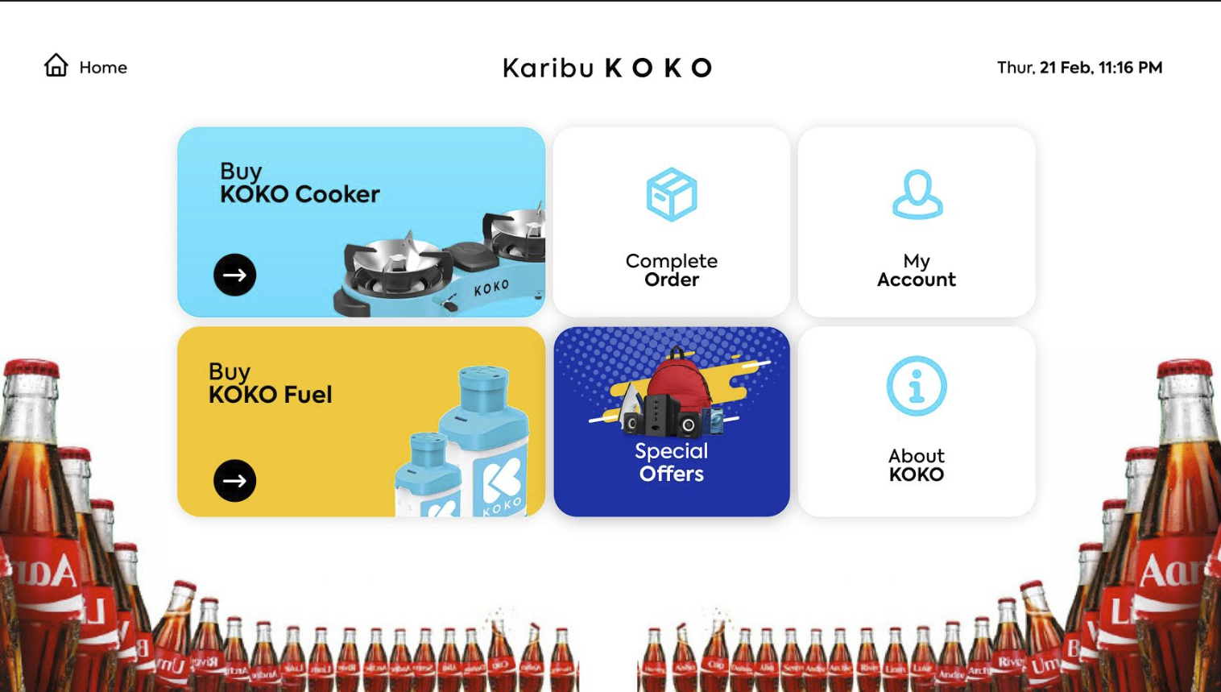
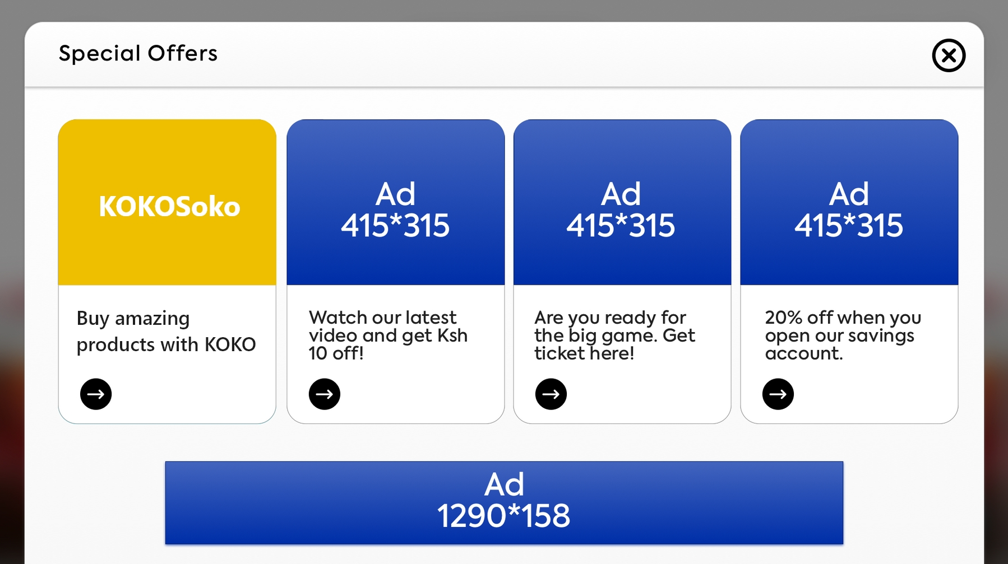
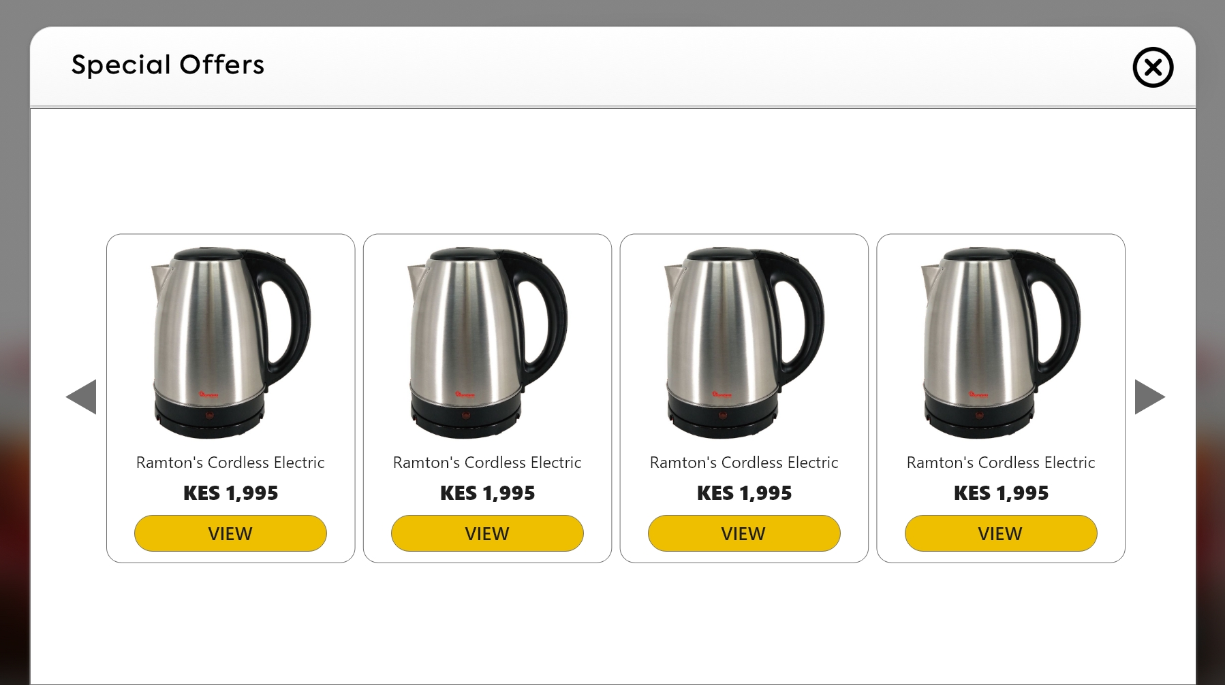
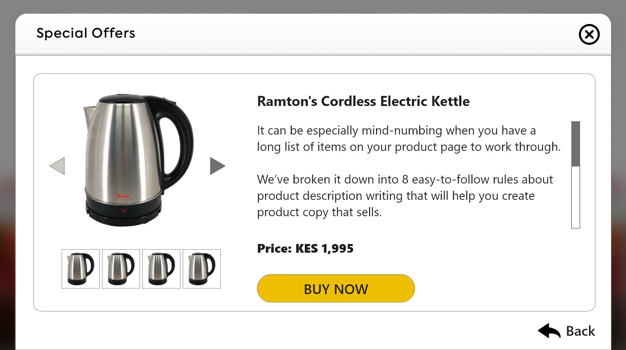
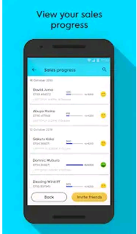
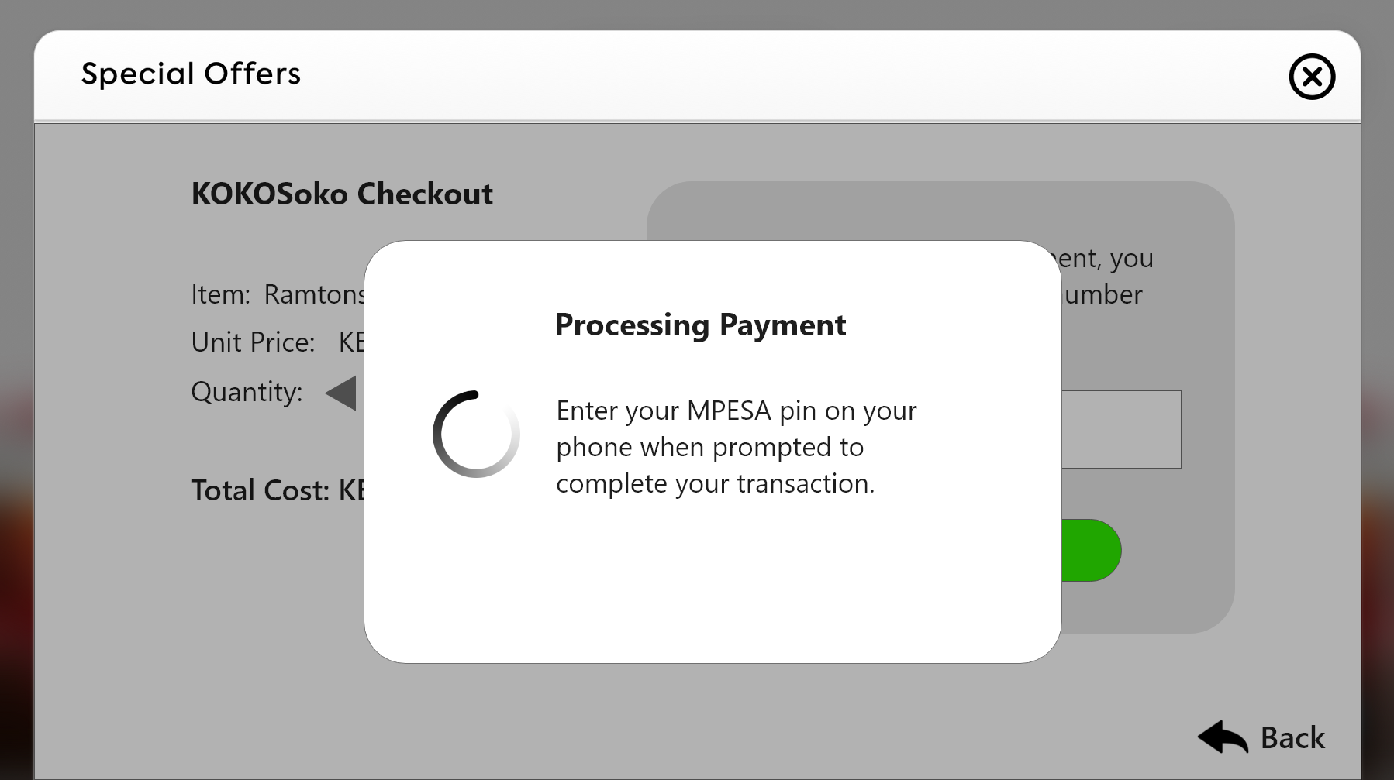
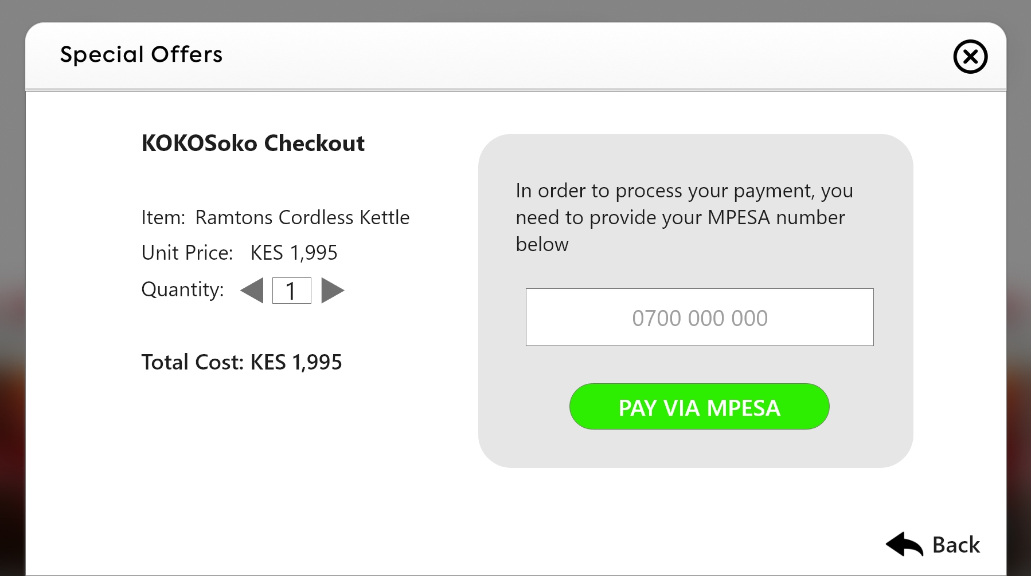
KOKOSoko Customer Transaction Success Journey
Customer can browse several products on offer...
Customer is made aware of promotion by the agent or advertisement from the KP
Customer clicks on “Special Offers” tab - out of own interest, and/or introduced by shopkeeper
… and learn more about the product details and capacity through photos
Your order is now ready for collection at your KOKO agent [name of shop]
If customer decides to buy the product, he will be asked to provide their phone number and select ‘pay via Mpesa to trigger STK push to their phone and input their Mpesa PIN to pay
Customer comes back to KP to enter collection code and pick-up product from agent
Customer receives text with order confirmation and when order is ready for collection with collection code
Customer completes Mpesa transaction from their phone and await purchase success message

Slide 9

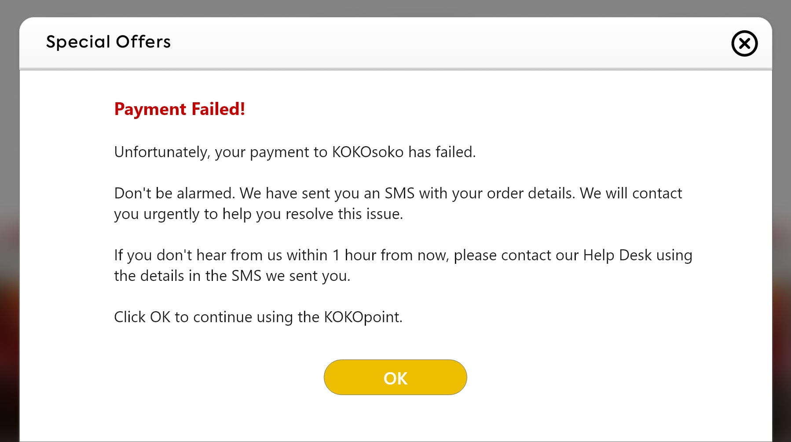
KOKOSoko Customer Transaction Failure Journey
Customer clicks on “Special Offers” tab - out of own interest, and/or introduced by shopkeeper
Customer can browse several products on offer...
… and learn more about the product details and capacity through photos
Your payment to KOKOsoko has failed, we will contact you within the 1 hour to resolve. Need Help? Call 0782234587
Customer is made aware of promotion by the agent or advertisement from the KP
If customer decides to buy the product, he will be asked to provide their phone number and select ‘pay via Mpesa to trigger STK push to their phone and input their Mpesa PIN to pay
Your order is now ready for collection at your KOKO agent [name of shop]
Customer receives payment failure SMS with contact details
Customer comes back to KP to enter collection code and pick-up product from agent
Customer receives text with order confirmation and when order is ready for collection with collection code
KOKO contacts customer within an hour to guide in manual payment processing
Customer completes Mpesa transaction from their phone and await purchase success message
Pop-up screen for failed STK push payments

Slide 10
KOKOSoko Deliverables
KP App: Send KP related info to the Special Offers webview (KP ID, Agent Shop Name, Agent Neighbourhood)
KOKO Media: Upgrade the Special Offers page to dynamically load app catalogue (App URL, App Icon URL, App Description)
KOKO Soko App: Build a web-based e-commerce platform where customers can buy tangible products using MPESA on the KP network.

Slide 11
KOKOsoko App Loading on KP
1. Tapping the KOKOsoko icon on Special Offers activates the KOKOsoko page on KM CMS.
5. If KOKOsoko is not cached, the CDN requests the app from the KM Media Server (S3).
DAP (Ad Butler)
2. KM CMS sends the Ad Zone tag to the KM DAP (Ad Butler).
6. KM Media Server (S3) returns the app to the CDN, which caches it.
2
3
KP App
(Special Offers Screen)
1
KOKO Media Test CMS
(Special Offers page)
4
KOKO Media CDN
(Cloudflare)
8
7
5
3. The KM DAP (Ad Butler) returns the KOKOsoko app URL to the CMS.
7. KM CDN returns the KOKOsoko app to the KM CMS.
KOKO Media Server (S3)
6
4. The KM CMS requests the app from the KM CDN.
8. KM CMS displays the KOKOsoko app on the Special Offers webview.

Slide 12
KOKOsoko KP Targeting
1. On SO screen load, KP app sends KP Serial to the WebView.
2. SO page on the KP WebView sends Ad Zone tag to Ad Butler with the KP Serial as a keyword.
KP App
(Special Offers Screen)
1
KOKO Media Test CMS
(Special Offers page)
2
KOKO Media DAP
(Ad Butler)
4
3
4. If the KOKOsoko app URL exists, the KOKOsoko app icon is displayed on the SO page.
3. KM DAP (Ad Butler) returns the KOKOsoko app URL if KP Serial matches the Ad Zone targeting.

Slide 13
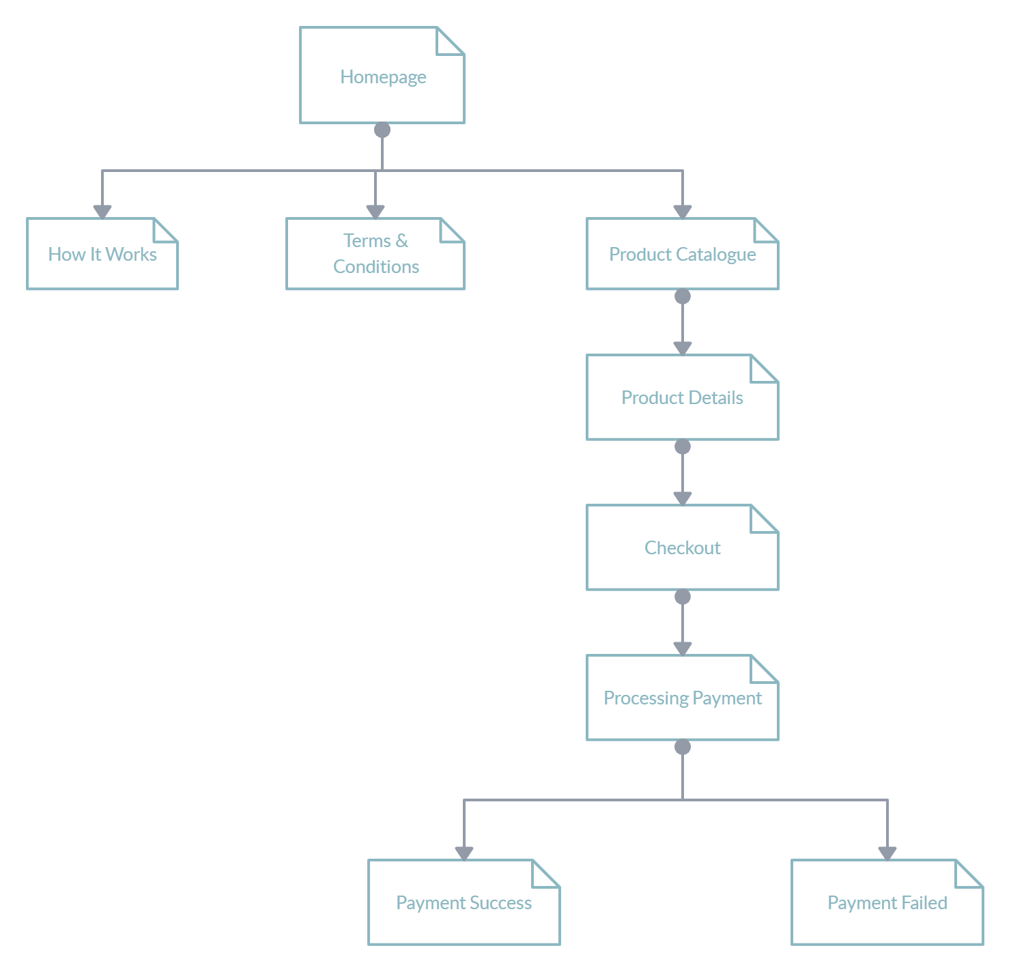
KOKOsoko App Sitemap
Full Diagram Link

Slide 14
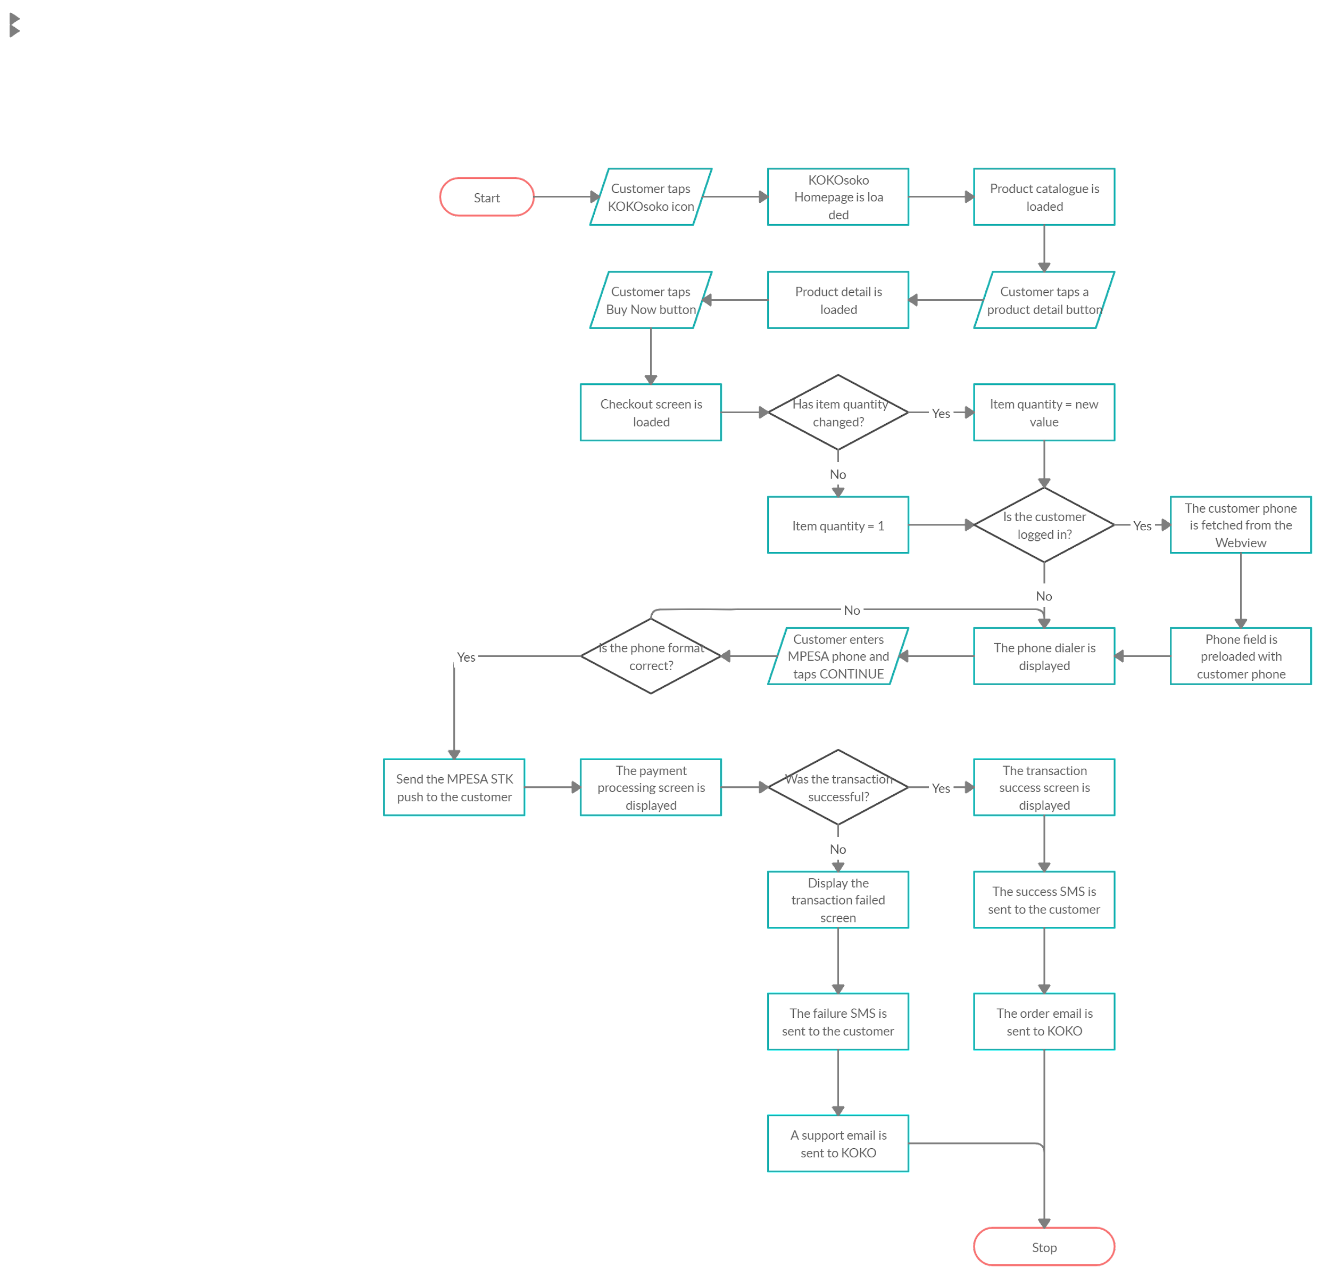
KOKOsoko Flow
Full Diagram Link

Slide 15
User Stories (Customer)
As a customer, I can open KOKOsoko page on the KP
As a customer, I can browse the product catalogue for KOKOsoko on KP.
As a customer, I can select a product on KOKOsoko and view the product details.
As a customer, I can pay for my order via MPESA STK push using my Safaricom number.
As a customer, I can receive a confirmation SMS after completing my payment transaction.
As a customer, I can receive a failure SMS in case of a failed transaction, with KOKOsoko contact information.

Slide 16
User Stories (KOKOsoko Manager)
As a manager, I can log into the secure KOKOsoko product CMS.
As a manager, I can manage (add, edit, delete) products in KOKOsoko product catalogue.
As a manager, I can receive details on completed orders through email from KOKOsoko.
As a manager, I can receive details on failed orders through email from KOKOsoko.
As a manager, I should be able to select participating KPs (Agent shops).

Slide 17
Concerns And Questions
Technical:
How do we fetch the Agent shop name, neighbourhood name from the KP for order fulfillment?
How should we collect analytics for customer engagement etc?
Process / Ops:
What is the contact details for KOKOsoko support?
What is the duration for order fulfillment?
What is the duration for customer response after failed transactions?
Where in the user journey should we ask for the customer’s number?
Reporting:
Which products in catalog were accessed most?
At what time of day?
How many people dropped off at payment page?

Slide 18
Relevant Links
Pre-scoping document
1-pager
KOKOsoko Wireframes
Copy document
KOKOsoko POC Design Brief

Slide 19
Kyrellos B. Nyawallow
k.nyawallow@kokonetworks.com
Mercy Langat
m.langat@kokonetworks.com

